Slide 1

Predictive Maintenance: Failure Prediction Model
By Ibrahim asiri

Slide 2
Introduction
- The different type of maintenance are
Preventive maintenance, corrective maintenance and predictive maintenance.
- Predictive maintenance go beyond time-scheduled maintenance to condition-based action to predict the likelihood of future failures by applying machine learning and data analytics to reduce asset failures and their costs.
- Build a machine learning model that predicts the machinery failure and types.
This model will help to recognize the machinery behavior to:
- Reduce the down time for the machine, spare parts inventory strategy, smooth operation and optimize maintenance cost by predicting the failures.

Slide 3
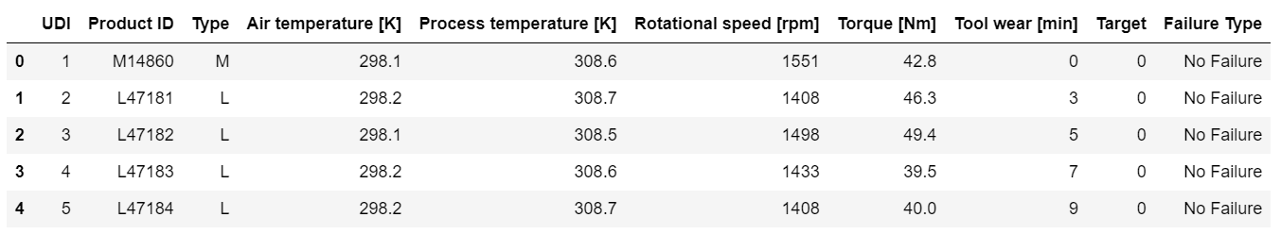
Data set
The dataset consists of 10 000 data points stored as rows with 10 columns:
Failure types : tool wear failure (TWF),heat dissipation failure (HDF),power failure (PWF), overstrain failure (OSF),random failures (RNF)
Acknowledgements
UCI : https://archive.ics.uci.edu/ml/datasets/AI4I+2020+Predictive+Maintenance+Dataset
Dua, D. and Graff, C. (2019). UCI Machine Learning Repository [http://archive.ics.uci.edu/ml].

Slide 4
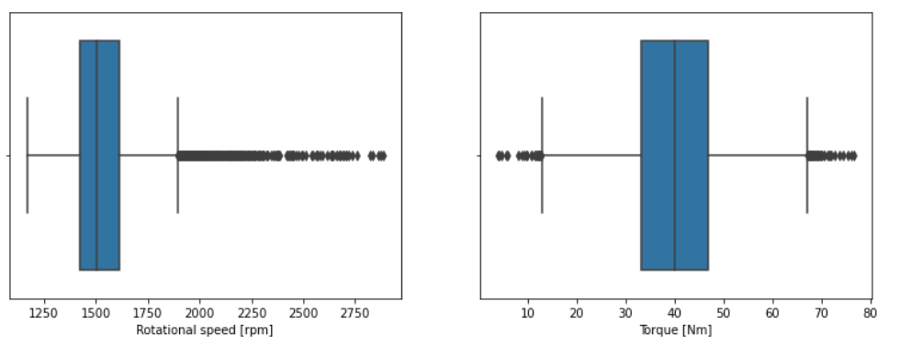
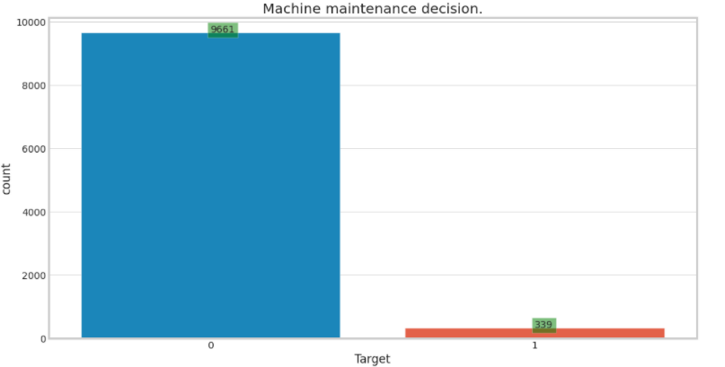
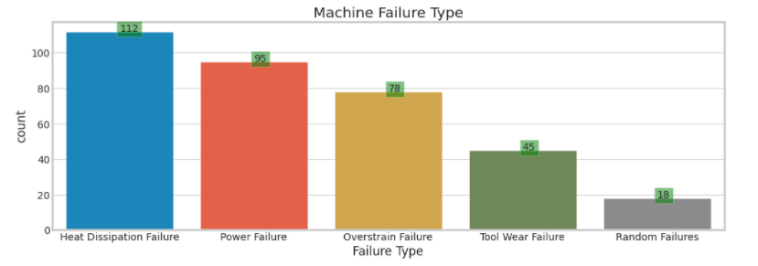
EDA and Data preparation
No missing data
Over-sampling using Smote would be required since the data is imbalanced (96.5% no failure ,3.5% failure happened)
Outliers in rotational speed and torque
Encoding for type and failure types

Slide 5
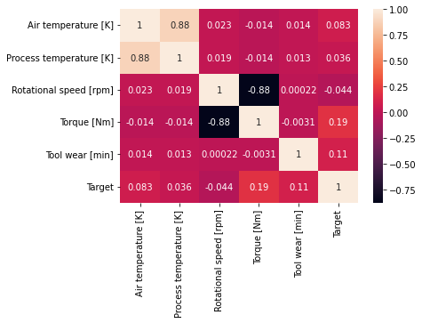
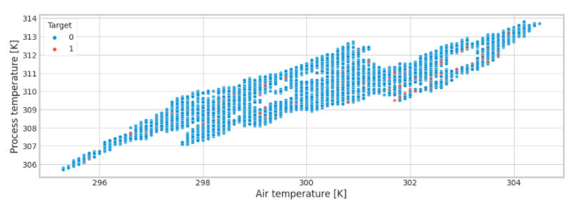
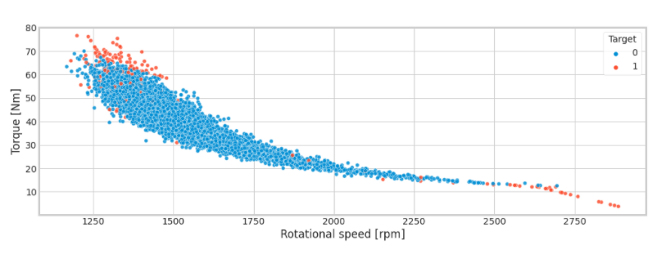
Plots and corr matrix

Slide 6
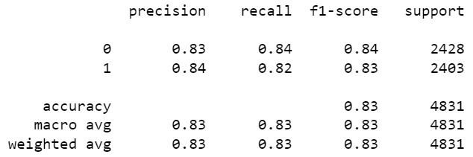
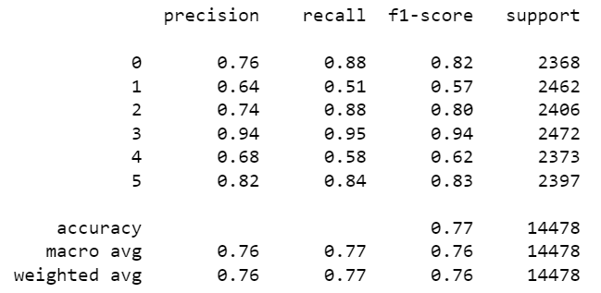
Logistic Regression model
1- Class report for failure prediction
2- Class report for failure type prediction
0 HDF 1 No failure 2 OSF 3 PF 4 RF 5 TWF

Slide 7
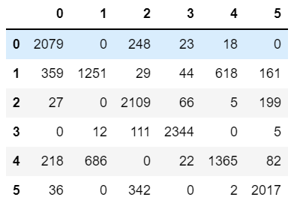
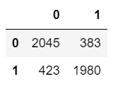
Logistic Regression model results
1- Confusion matrix , class report & Kfold for failure prediction
2- Confusion matrix , class report & Kfold for failure type prediction

Slide 8
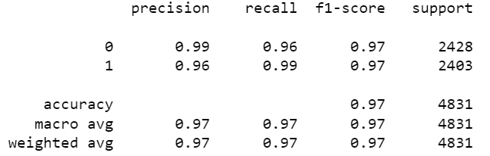
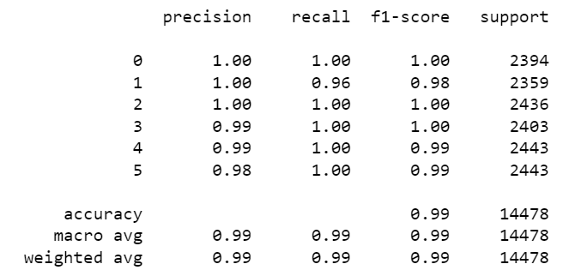
Random Forest model
3- Class report for failure prediction
4- Class report for failure type prediction
0 HDF 1 No failure 2 OSF 3 PF 4 RF 5 TWF

Slide 9
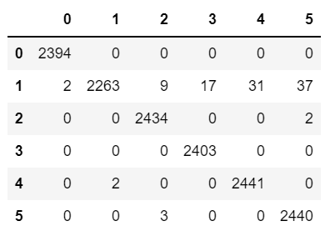
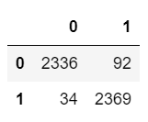
Random Forest model results
3- Confusion matrix , class report & Kfold for failure prediction
4- Confusion matrix , class report & Kfold for failure type prediction

Slide 10
Conclusion
- More features to be collected to and make the model more complex.
- Use sensors to monitor the machine, then continuously evaluates it against historical trends to predict failure before it occurs.

